Slide 1


Exploratory Data Analysis on AUTOMOBILES

Slide 2

Shahbaz
Presented by
Pricing Analyst
Ford Motor Private Ltd

Slide 3

Introduction
This is a Python based EDA project done out of an Automobile Dataset, where we have explored and analysed three major factors of a car which are as below:
Price
Mileage
Performance
We have also identified the ‘Best Car’ under the ‘Low Budget Car-Category’.

Slide 4
Dataset Description
The Automobile Dataset consists of various information relating to the built, engine power, make, mileage and body attributes of a car. The data types include integers, floating points and strings.
The variables have been segregated as below.
General Attributes | Physical Attributes | Technical Attributes | Safety Related
Make | No. of Doors | Fuel Type | Symboling
Price | Body Style | Aspiration | Normalized losses
City MPG | Wheel Drive | Engine Type
Highway MPG | Engine location | Fuel System
Horsepower | Wheel Base | Bore
 | Length | Stroke
 | Width | Compression Ratio
 | Height | Peak RPM
 | Curb Weight

Slide 5

Price Analysis

Slide 6
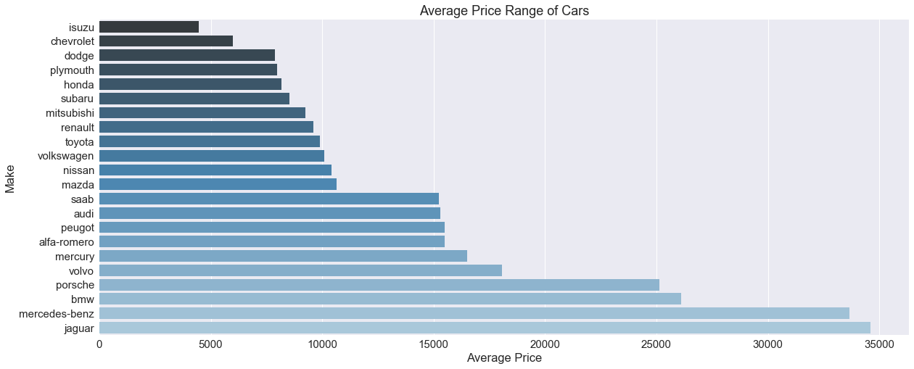
Classification based on Price
Low Price Segment
Medium Price Segment
Premium Cars

Slide 7
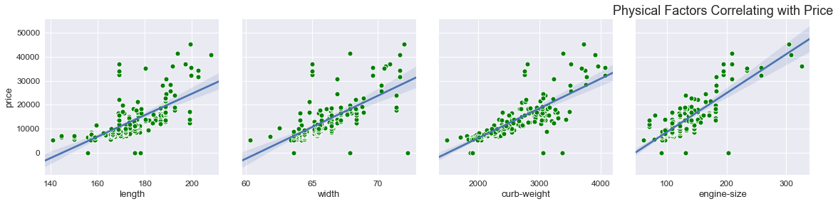
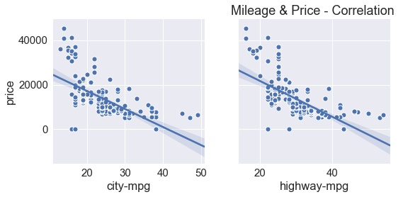
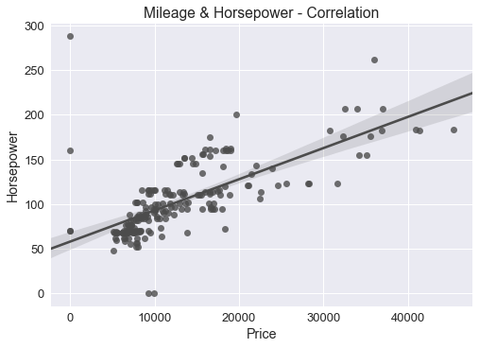
Attributes Correlating with Price

Slide 8
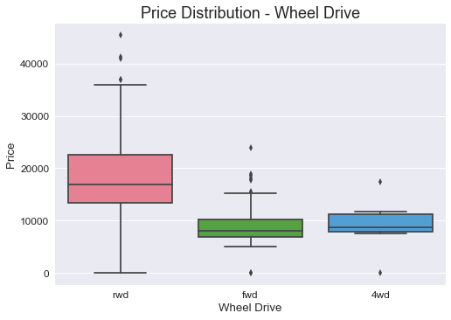
Price Distribution Based on Wheel Drive

Slide 9
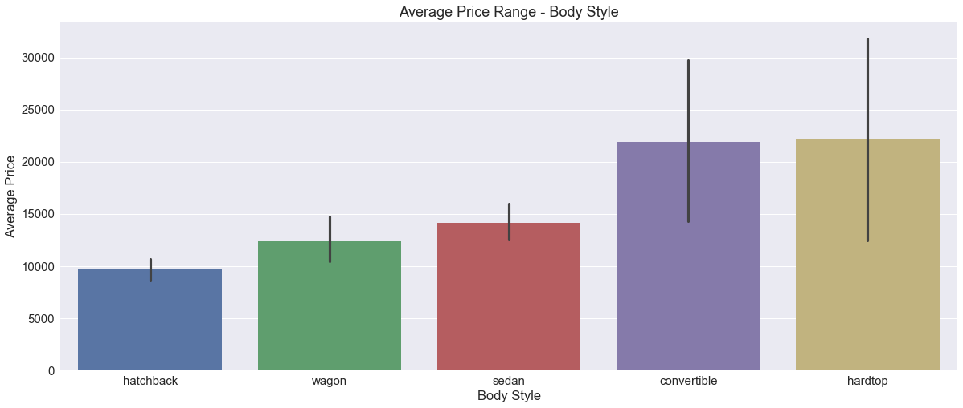
Average Price of Body Styles

Slide 10

Performance Analysis

Slide 11
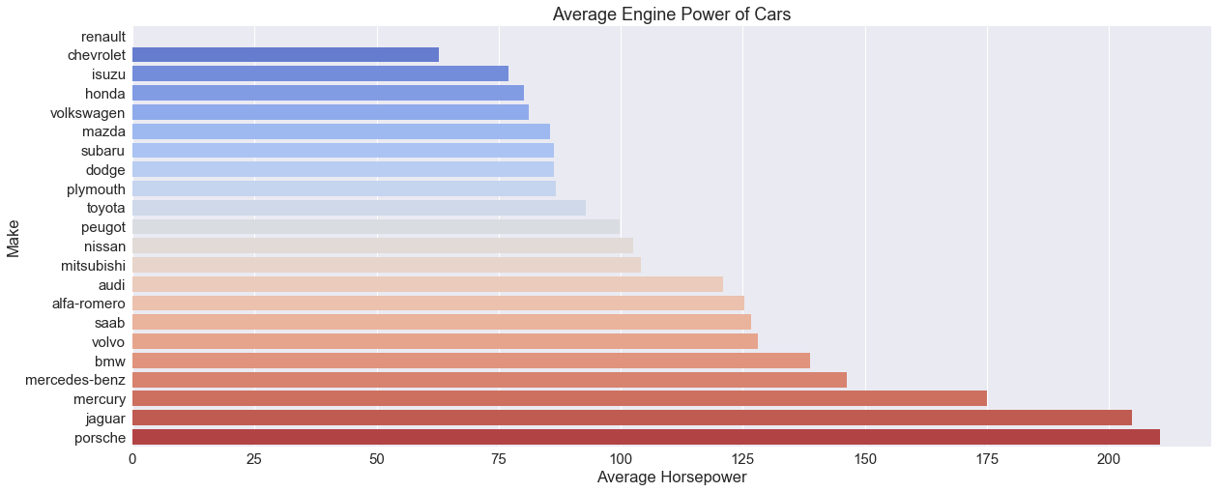
Classification of Cars Based on Engine Power
Average Performance Cars
Medium Performance Cars
High
Performance Cars

Slide 12
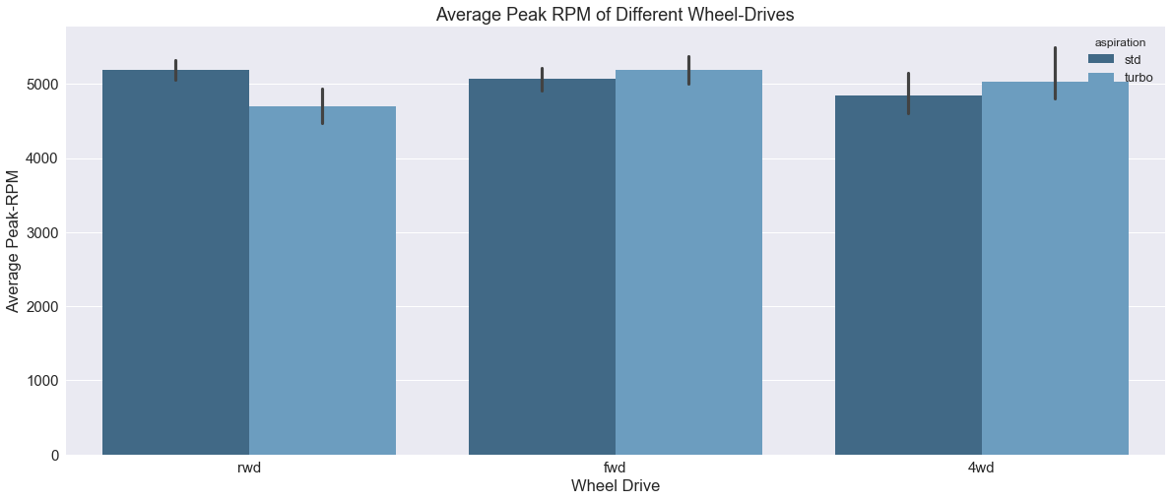
Average Peak RPM Comparison on Wheel Drive

Slide 13
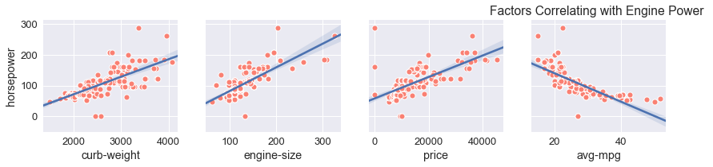
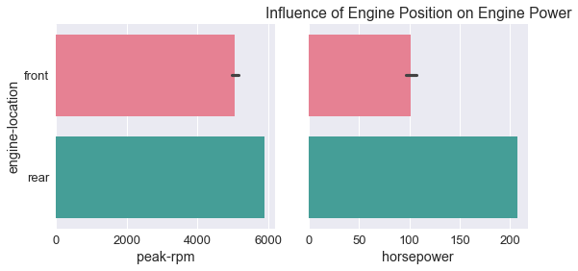
Factors Influencing & Influenced by the Engine Power

Slide 14

Mileage Analysis

Slide 15
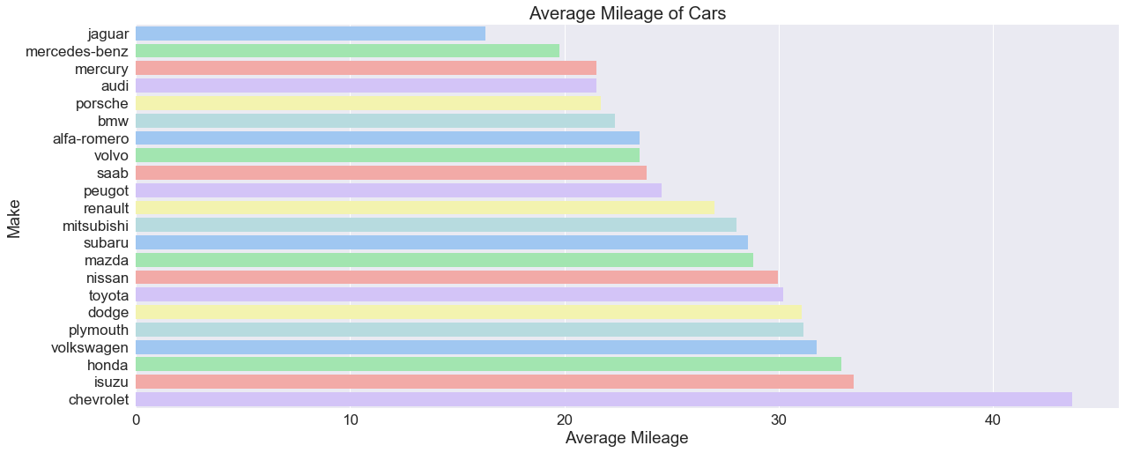
Mileage Comparison of Cars

Slide 16
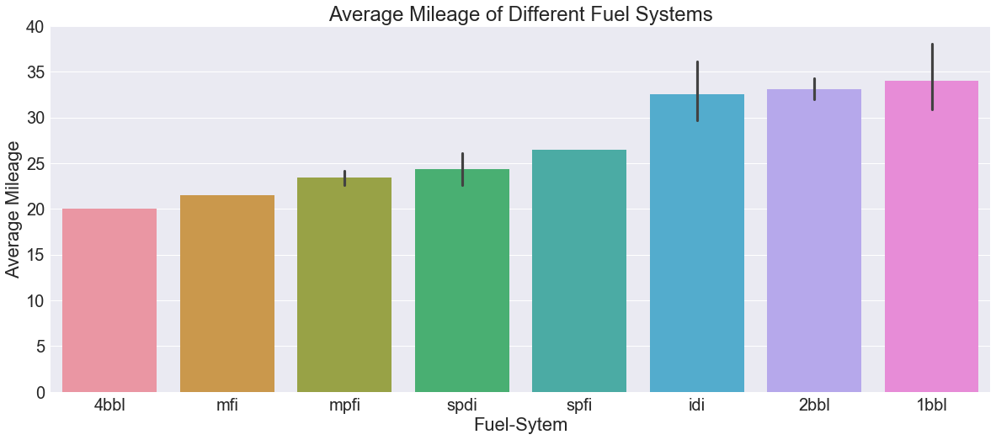
Mileage Comparison With Different Fuel Systems

Slide 17
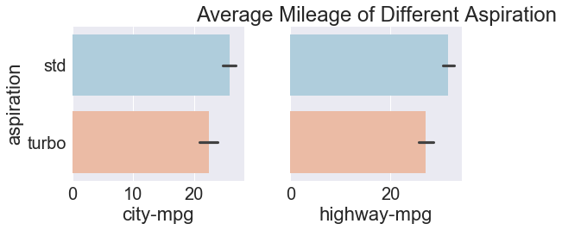
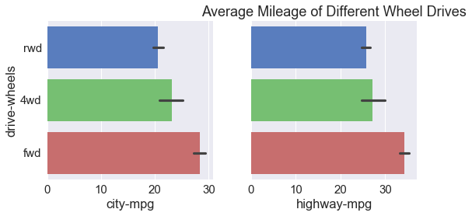
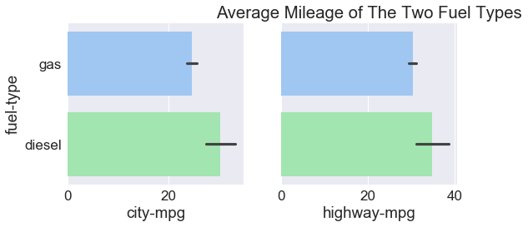
Mileage Comparison With Other Attributes

Slide 18
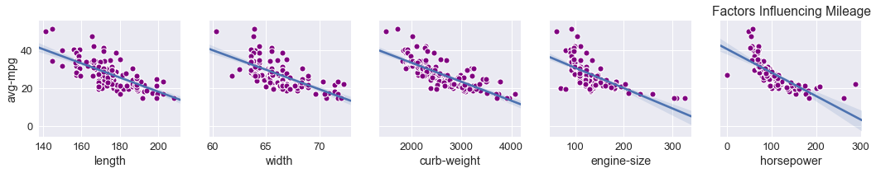
Factors Influencing Mileage

Slide 19

Best Budget Car Analysis

Slide 20
Cars Qualifying for The ‘Budget Car’ Category
Vehicle line | Avg Price
Chevrolet | 6675
Renault | 9895
Isuzu | 11048
Subaru | 11694
Plymouth | 12764
Honda | 12945
Dodge | 12964
Volkswagen | 13845
Mitsubishi | 14869
Alfa Romero | 16500
Mercury | 16503
Toyota | 17669
Low Segment
Price Range = 6000 to 17000

Slide 21
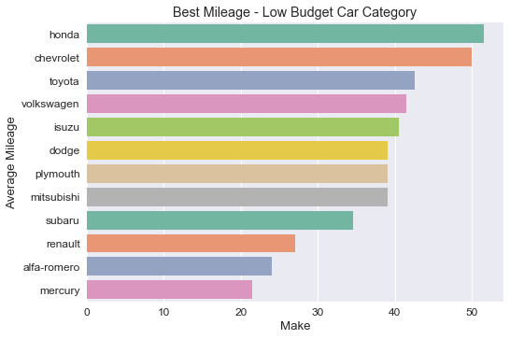
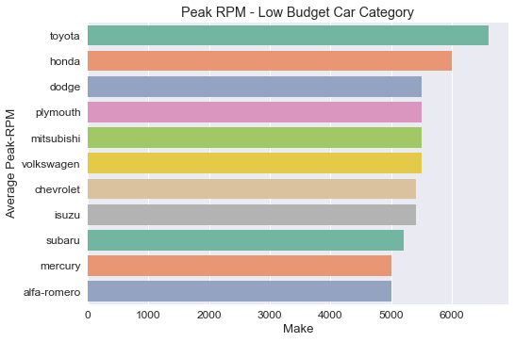



Feature Analysis of The Qualified Cars
Top 3 Qualifiers

Slide 22
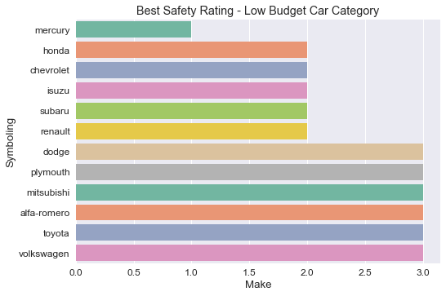
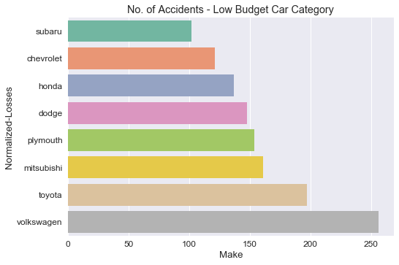




Feature Analysis of The Qualified Cars
Top 3 Qualifiers

Slide 23
Final Qualifiers
Vehicle line | Avg Price
Honda | 4
Chevrolet | 3
Toyota | 2
Subaru | 2
Dodge | 1
Mercury | 1
Isuzu | 1
Renault | 1

Slide 24
Thank You!
“If you think you can do a thing or think you can't do a thing, you're right.”
-Henry Ford

Slide 25
Any Suggestions or Questions?
You can mail us at:
shabaz7775@gmail.com

